Slide 1
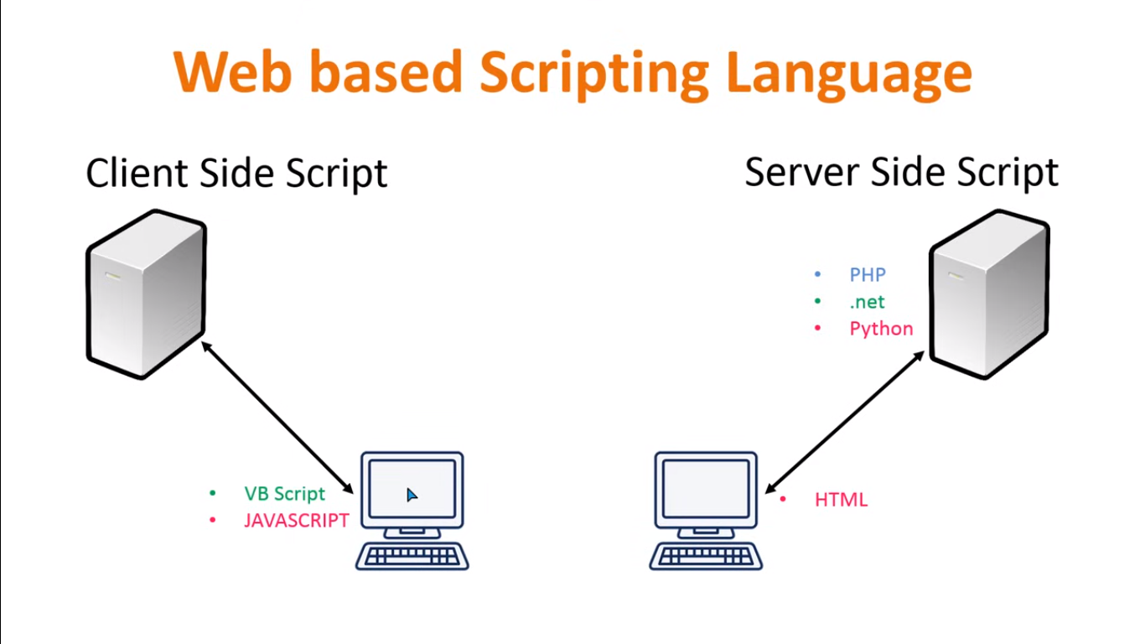

Slide 2
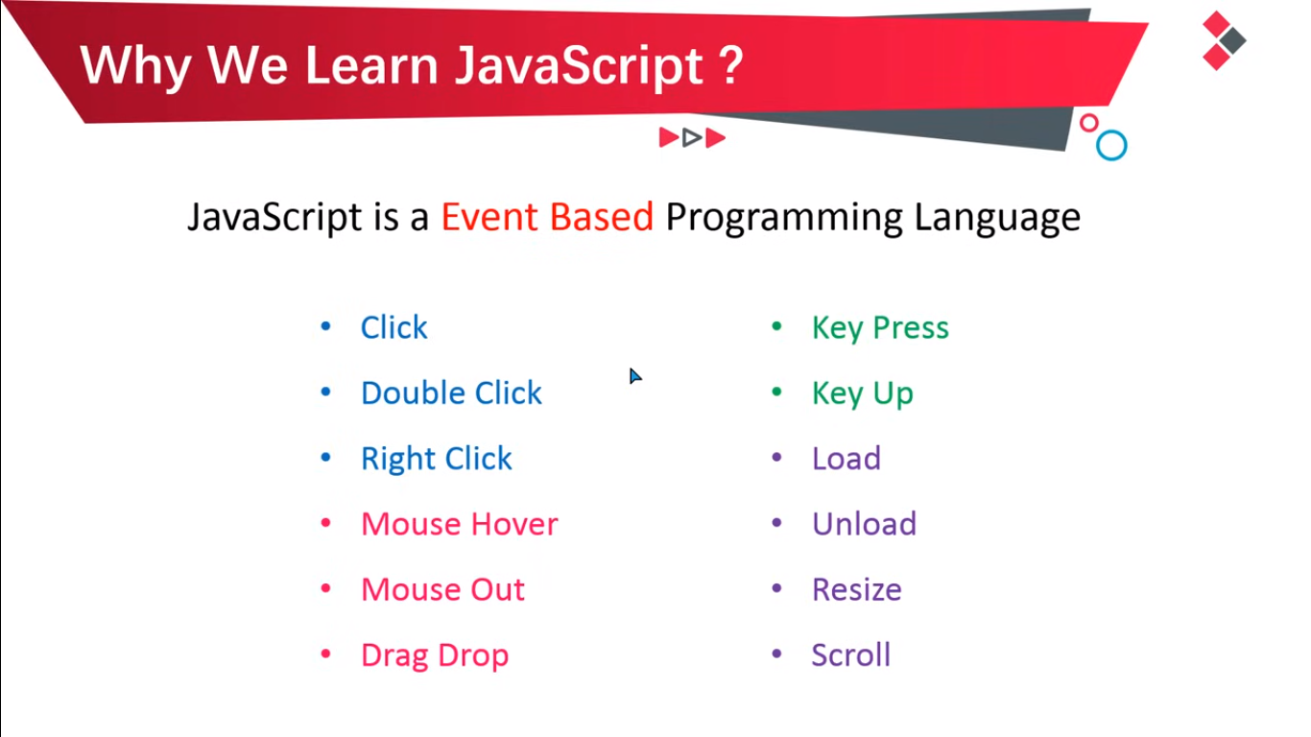

Slide 3
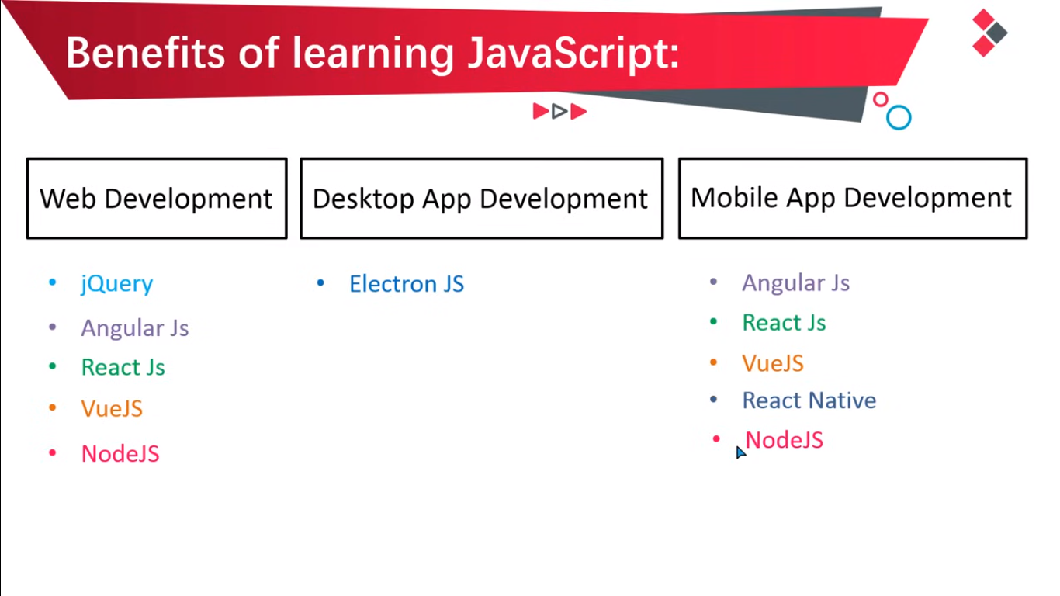

Slide 4
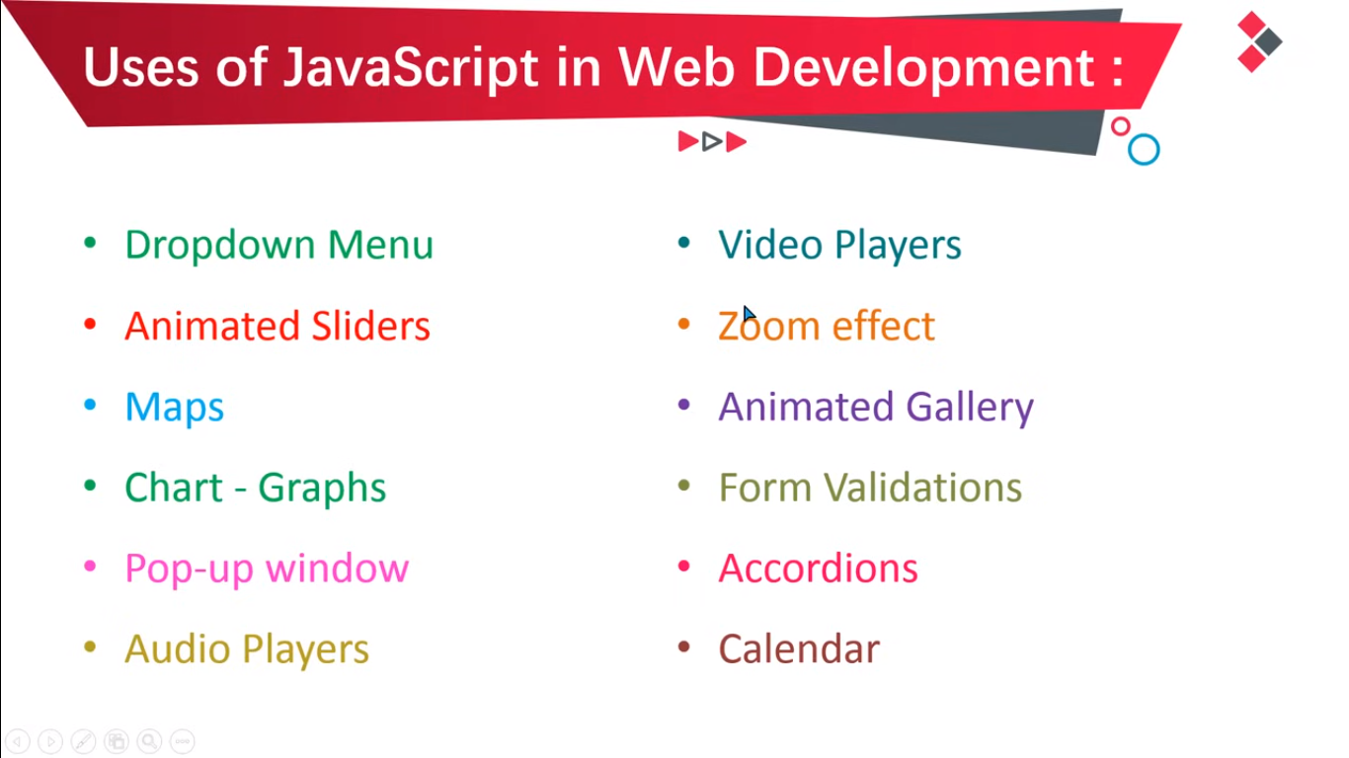

Slide 5
Array slice()
The slice() method returns selected elements in an array, as a new array.
The slice() method selects from a given start, up to a (not inclusive) given end.
The slice() method does not change the original array.

Slide 6
Array splice()
The splice() method adds and/or removes array elements.
The splice() method overwrites the original array.

Slide 7
Array some()
Parameters: This method accepts five parameters as mentioned above and described below:
callback: This parameter holds the function to be called for each element of the array.
element: The parameter holds the value of the elements being processed currently.
index: This parameter is optional, it holds the index of the currentValue element in the array starting from 0.
array: This parameter is optional, it holds the complete array on which Array.every is called.
thisArg: This parameter is optional, it holds the context to be passed as this is to be used while executing the callback function. If the context is passed, it will be used like this for each invocation of the callback function, otherwise undefined is used as default.
Return value: This method returns true even if one of the elements of the array satisfies the condition(and does not check the remaining values) implemented by the argument method. If no element of the array satisfies the condition then it returns false.

Slide 8
Array find() Method
Parameters: This method accepts 5 parameters as mentioned above and described below:
function: It is the function of the array that works on each element.
currentValue: This parameter holds the current element.
index: It is an optional parameter that holds the index of the current element.
arr: It is an optional parameter that holds the array object to which the current element belongs to.
thisValue: This parameter is optional. If a value is to be passed to the function to be used as its “this” value else the value “undefined” will be passed as its “this” value.
Return value: It returns the array element value if any of the elements in the array satisfy the condition, otherwise it returns undefined.

Slide 9
JS Objects
A javaScript object is an entity having state and behavior (properties and method). For example: car, pen, bike, chair, glass, keyboard, monitor etc.
JavaScript is an object-based language. Everything is an object in JavaScript.
JavaScript is template based not class based. Here, we don't create class to get the object. But, we direct create objects.

Slide 10
JS Objects
Creating Objects in JavaScript
There are 3 ways to create objects.
By object literal
By creating instance of Object directly (using new keyword)
By using an object constructor (using new keyword)
1) JavaScript Object by object literal
2) By creating instance of Object
3) By using an Object constructor

Slide 11
CONST ARRAYS
The code above has an array variable called numbers holding three values. Even though the numbers array is a const you’re able to update or change the variable. For example, you can add another number to the numbers array by using the push method. Methods are actions you perform on the array or object. const numbers = [1,2,3]; numbers.push(4); console.log(numbers) // Outpusts [1,2,3,4];

Slide 12
CONST OBJECTS
The modifying principle applies to an object for example. const user = { name: "Gary", } user.age = 29 console.log(user) // {name: "Gary", age: 29
The code above creates a user object with a name property then it assigns a new age property to object. One thing to remember const does not stop array and objects from being modified it only stops the variable itself from being reassigned or being overwritten for example. const user = { name: "Gary", } person = { name: "Bob" } // Uncaught TypeError: Assignment to constant variable.

Slide 13
JS Map Method
map() creates a new array from calling a function for every array element.
map() does not execute the function for empty elements.
map() does not change the original array.

Slide 14
JS Map Method
Parameters
Parameter | Description
function() | Required. A function to be run for each array element.
currentValue | Required. The value of the current element.
index | Optional. The index of the current element.
arr | Optional. The array of the current element.
thisValue | Optional. Default value undefined. A value passed to the function to be used as its this value.
Return Value
Type | Description
An array | The results of a function for each array element.

Slide 15
String Methods:
Instance Methods | Description
at() | Find the character at the specified index.
anchor() | Creates an anchor element that is used as a hypertext target.
charAt() | Returns that character at the given index of the string.
charCodeAt() | Returns a Unicode character set code unit of the character present at the index in the string.
codePointAt() | Return a non-negative integer value i.e, the code point value of the specified element.
concat() | Join two or more strings together in JavaScript.
endsWith() | Whether the given string ends with the characters of the specified string or not.
includes() | Returns true if the string contains the characters, otherwise, it returns false.
indexOf() | Finds the index of the first occurrence of the argument string in the given string.
lastIndexOf() | Finds the index of the last occurrence of the argument string in the given string.
localeCompare() | Compare any two elements and returns a positive number

Slide 16
String Methods:
match() | Search a string for a match against any regular expression.
matchAll() | Return all the iterators matching the reference string against a regular expression.
normalize() | Return a Unicode normalization form of a given input string.
padEnd() | Pad a string with another string until it reaches the given length from rightend.
padStart() | Pad a string with another string until it reaches the given length from leftend.
repeat() | Build a new string containing a specified number of copies of the string.
replace() | Replace a part of the given string with some another string or a regular expression
replaceAll() | Returns a new string after replacing all the matches of a string with a specified string/regex.
search() | Search for a match in between regular expressions and a
slice() | Return a part or slice of the given input string.
split() | Separate given string into substrings using a specified separator provided in the argument.
startsWith() | Check whether the given string starts with the characters of the specified string or not.

Slide 17
String Methods:
substr() | Returns the specified number of characters from the specified index from the given string.
substring() | Return the part of the given string from the start index to the end index.
toLocaleUpperCase() | Returns the calling string value converted to a uppercase letter.
toUpperCase() | Converts the entire string to uppercase.
toString() | Return the given string itself.
trim() | Remove the white spaces from both ends of the given string.
trimEnd() | Remove white space from the end of a string.
trimStart() | Remove white space from the start of a string.
valueOf() | Return the value of the given string.
string[Symbol.iterator]() | This method is used to make String iterable. [@@iterator]() returns an iterator object which iterates over all code points of the String.
toLowerCase() | Converts the entire string to lowercase.
toLocaleLowerCase() | Returns the calling string value converted to a lowercase letter.

Slide 18
JS Number Methods
Method | Description
toString() | Returns a number as a string
toExponential() | Returns a number written in exponential notation
toFixed() | Returns a number written with a number of decimals
toPrecision() | Returns a number written with a specified length
ValueOf() | Returns a number as a number

Slide 19
JS Math Methods
Methods | Description
abs() | It returns the absolute value of the given number.
acos() | It returns the arccosine of the given number in radians.
asin() | It returns the arcsine of the given number in radians.
atan() | It returns the arc-tangent of the given number in radians.
cbrt() | It returns the cube root of the given number.
ceil() | It returns a smallest integer value, greater than or equal to the given number.
cos() | It returns the cosine of the given number.
cosh() | It returns the hyperbolic cosine of the given number.
exp() | It returns the exponential form of the given number.
floor() | It returns largest integer value, lower than or equal to the given number.
hypot() | It returns square root of sum of the squares of given numbers.
log() | It returns natural logarithm of a number.

Slide 20
JS Math Methods
Methods | Description
max() | It returns maximum value of the given numbers.
min() | It returns minimum value of the given numbers.
pow() | It returns value of base to the power of exponent.
random() | It returns random number between 0 (inclusive) and 1 (exclusive).
round() | It returns closest integer value of the given number.
sign() | It returns the sign of the given number
sin() | It returns the sine of the given number.
sinh() | It returns the hyperbolic sine of the given number.
sqrt() | It returns the square root of the given number
tan() | It returns the tangent of the given number.
tanh() | It returns the hyperbolic tangent of the given number.
trunc() | It returns an integer part of the given number.

Slide 21
JS Date Methods
Method | Description
getFullYear() | Get year as a four digit number (yyyy)
getMonth() | Get month as a number (0-11)
getDate() | Get day as a number (1-31)
getDay() | Get weekday as a number (0-6)
getHours() | Get hour (0-23)
getMinutes() | Get minute (0-59)
getSeconds() | Get second (0-59)
getMilliseconds() | Get millisecond (0-999)
getTime() | Get time (milliseconds since January 1, 1970)

Slide 22
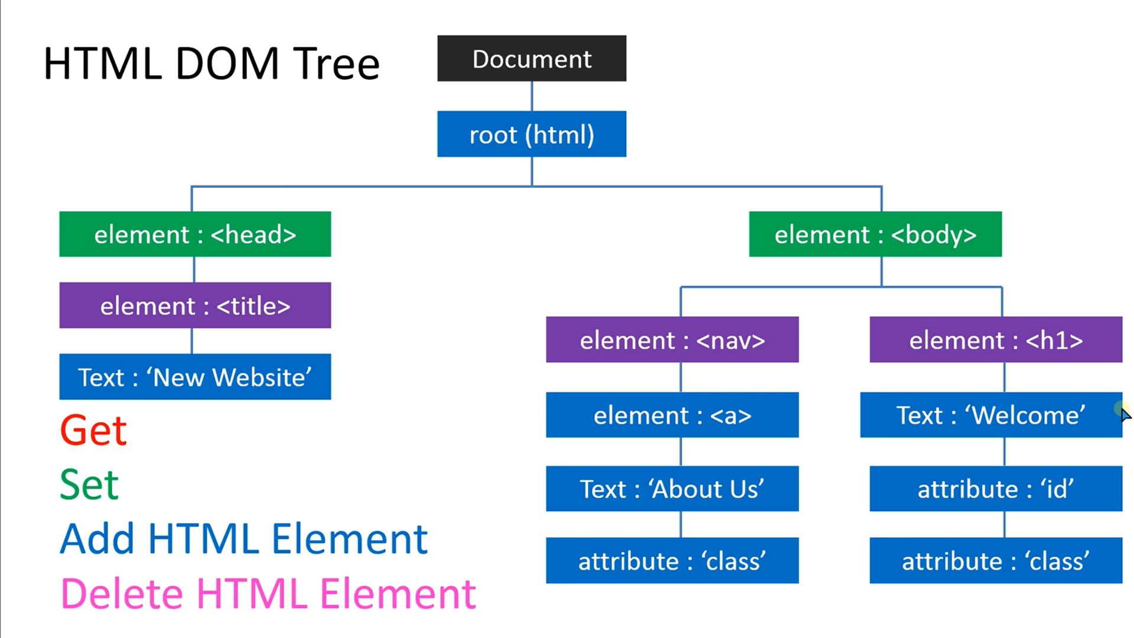
JS DOM Introduction

Slide 23
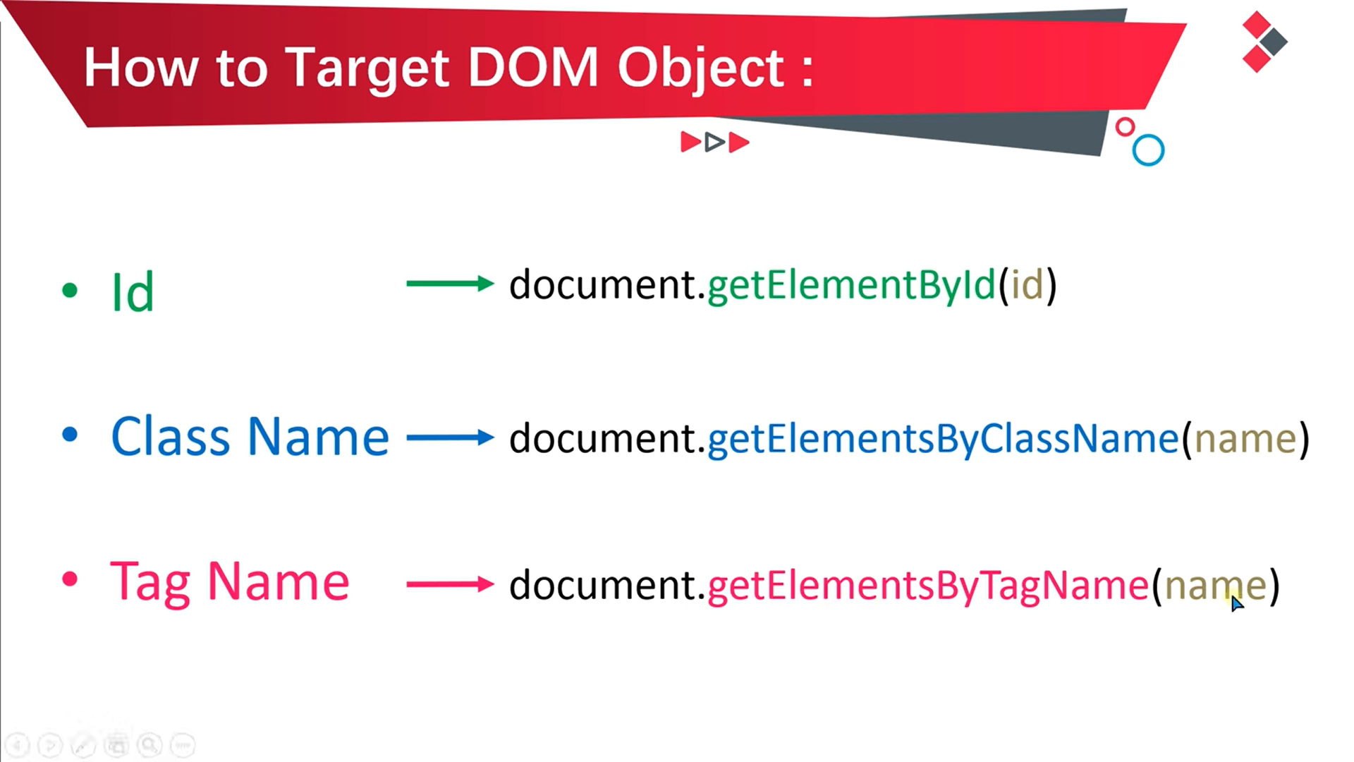

Slide 24
